Slide 1




Stand Out & Connect
The Jobseeker’s Guide to Personal Branding & Networking
Facilitated By:
Ali Dossa
Manager E.O Services YWCA Hamilton.
| ywcahamilton.org

Slide 2


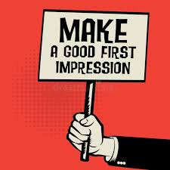
Why Branding Matters in Job Search
Makes you memorable
Shows what you stand for
Aligns your resume, LinkedIn, and interviews
Builds trust and credibility
Sets you apart
Notes:
The Importance of First Impressions:
The interview is your chance to make a strong first impression. Be confident, positive, and professional. Your handshake, body language, and tone set the stage for the interview, so greet your interviewer warmly and start the conversation on a good note.
Showcase Your Fit:
Employers want candidates who have the right skills and fit the company culture. Highlight your relevant experience and show how your values align with the company’s goals. Tailor your answers to demonstrate why you're the best fit for the job.
Stand Out from the Competition:
Even with similar qualifications, good interview skills can make you stand out. Be clear about your achievements, problem-solving approach, and enthusiasm for the role. Practice common questions and prepare examples that show your skills and make you memorable.
Get the Job Offer:
Clear communication and preparation are key to landing the job. Answer questions concisely, ask insightful questions, and follow up with a thank-you note. This shows you're genuinely interested, which increases your chances of getting the offer.
By following these steps, you can make a great first impression, show you're the right fit, and stand out from other candidates, boosting your chances of getting the job.

Slide 3


Your Elevator Pitch (Your Verbal Brand)
Introduction:
Start with your name and a brief, engaging opening line.
For e.g, "Hi, I’m Alex, and I'm a Marketing Professional with a passion for Digital Marketing”.
2. What You Do:
Clearly and concisely explain your key skills and areas of expertise.
3. Your Value Proposition:
Articulate what makes you unique and valuable.
4. Your Career Goals:
Mention your short-term and long-term career aspirations
5. The Call to Action:
Asking for a business card or suggesting a follow-up meeting.

Slide 4
My Elevator Pitch
1. Introduction:
“Hi, my name is Echo, and I’m a Workshop Facilitator passionate about helping individuals overcome barriers to meaningful employment.”
2. What You Do:
“I specialize in designing and facilitating engaging, people-centered employment workshops, building personalized action plans, and connecting job seekers with inclusive employers across the community.”
3. Your Value Proposition:
“What sets me apart is my ability to combine strong facilitation skills with relationship building — I not only empower clients to build confidence and skills, but also collaborate with employers to create equitable and sustainable opportunities.”
4. Your Career Goals:
“In the short term, I aim to continue supporting diverse job seekers through YWCA Hamilton’s employment programs, and long term, I hope to take on a leadership role in program development where I can shape inclusive employment strategies on a larger scale.”
5. The Call to Action:
“I’d love to stay connected and explore how we might collaborate. Do you have a business card, or would you be open to a follow-up conversation next week?”

Slide 5
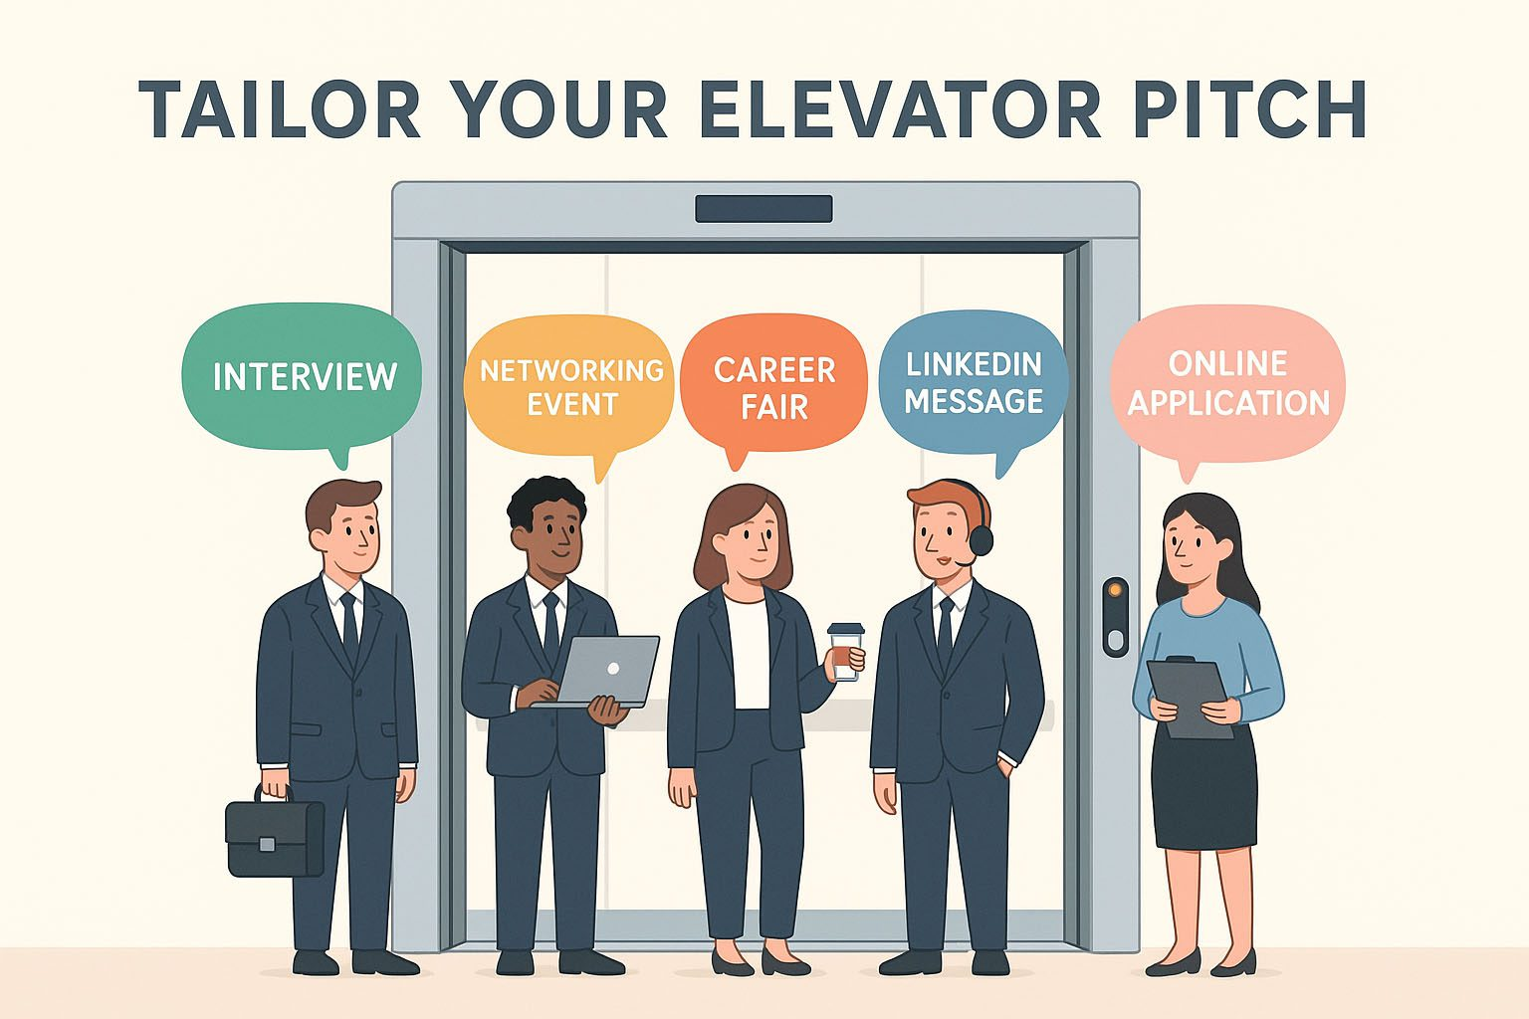
Building Your Own Elevator Pitch
Notes:
Ask participants to building their own elevator pitch and share with the group

Slide 6


Action Plan: Start Today
Write your brand statement
Update your resume and LinkedIn
Reach out to 3 new contacts
Attend 1 event
Book a meeting with your advisor

Slide 7


Support from our EO Office
Resume & Cover Letter Assistance
Job Search Techniques
Mock Interviews
Job Matching & Referrals
Access to resource centre

Slide 8


QUESTIONS?
| ywcahamilton.org

