Slide 1
Connect to Careers: Job Fair Prep Workshop

Slide 2
Workforce Planning Hamilton
Labour Market 101
Feb 2025
Connect to Careers
Visit Our Website
workforceplanninghamilton.ca

Slide 3
About Us
Workforce Planning Hamilton (WPH) is a Hamilton-based community planning organization that builds solutions to labour market issues thorough community engagement and partnership. We are part of a larger network of 25 workforce planning boards across Ontario. A not-for-profit, we are funded by the Ministry of Labour, Immigration, Training and Skills Development.

Slide 4
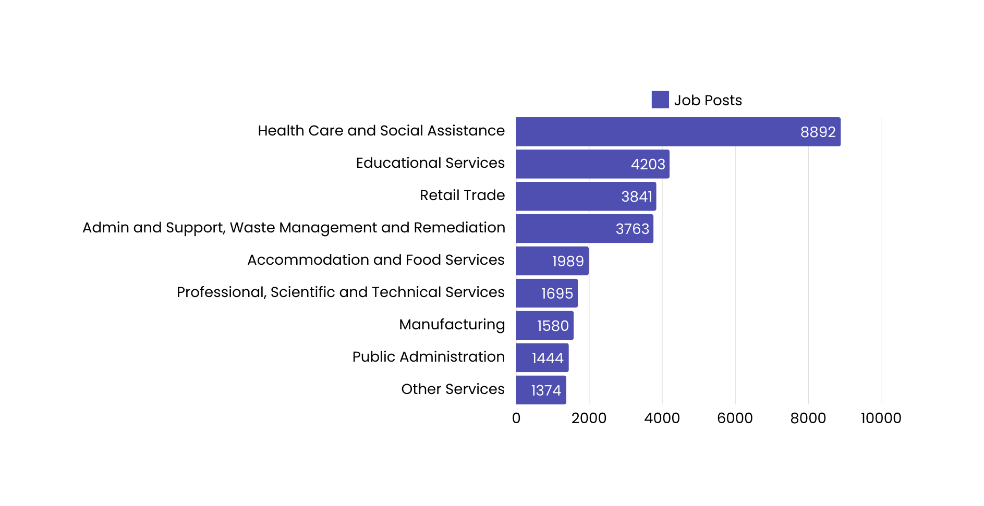
Job Demand in Hamilton
WPH’s Job Board collects data on in-demand jobs in the region. In 2024, we collected over 49,108 job postings from 7,895 employers in the region. These were the most prominent sectors.
Performance Expectations Of Employees & Superiors
Setting Performance Standards

Slide 5
In-Demand Jobs
Job Title | # of Job Posts | Median Wage
Registered Nurses | 2,291 | $41.00
Retail Salespersons | 1,937 | $17.20
Store Clerks and Stockers | 1,041 | $17.20
Food Service Jobs | 1,038 | $17.20
Cooks | 1,012 | $17.20
Administrative Assistants | 955 | $25.00
Home Support Workers | 846 | $22.00
Retail and Wholesale Trade Managers | 829 | $42.78
Social and Community Service Workers | 822 | $25.22

Slide 6
In-Demand Skills
Communication
Management
Organization
Customer Service
Interpersonal

Slide 7
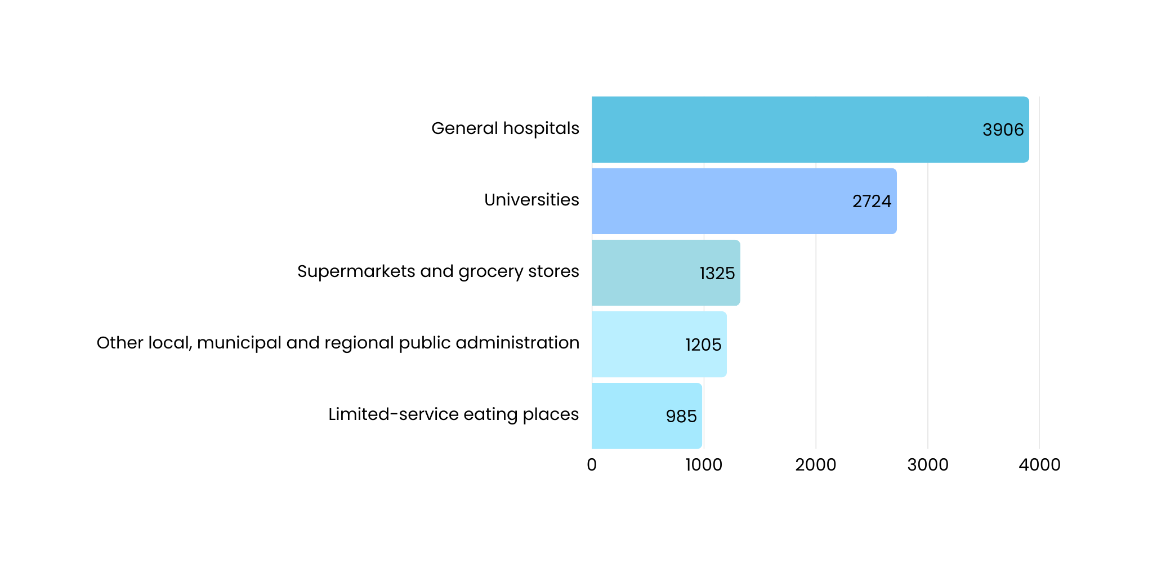
Top Hiring Sectors
Performance Expectations Of Employees & Superiors
Setting Performance Standards

Slide 8
Job Fair Overview
Job fairs allow job seekers to:
connect and interact with employers, recruiters, hiring managers in one place.
find out about different career opportunities and explore different options
grow your network and meet new people
Tips for Preparing for a Job Fair
Professional Appearance is important
Good First Impressions for Employers - you will interact with Employers who can hire you
Do your research about which employers are there and where their booth is
Resumes should be up to date and printed

Slide 9
Tuesday March 4th 2025
10am -3pm ( arrive at 2pm latest)
Hamilton Convention Centre, 1 Summers Lane
Event Details:
You must register in advance
2 floors of employers - escalators and elevators
100+ Employers
2000+ job seekers - very busy! (not really kid-friendly)
Large rooms where each employer has their own booth
Website has all the information about employers - do your research.
Give yourself at least 2 hours - the line may be long, dress for the weather

Slide 10
Connect to Careers
Online Registration is REQUIRED before the event

Slide 11
How to REGISTER
To register you will need:
First & Last Name
Email Address
City you live in
Create a Password
Confirm if you are:
Student
Alumni
Community Job Seeker
There are additional questions about level of education, previous role titles, jobs you are looking for - these are NOT mandatory
LET’S REGISTER TOGETHER!
www.connecttocareers.ca

Slide 12
After Registration
You will recieve an EMAIL confirmation with a QR code
SAVE, PRINT, SCREENSHOT, or SAVE TO APPLE/GOOGLE WALLET
You will need to show the QR code to enter on March 4th
The Connect to Careers Website lists all the employers who will be there and the jobs they are hiring and their booth number
Look for the WHO’S HIRING? Tab

Slide 13
Who’s Hiring at Connect to Careers?
Full time, part time, casual, volunteer, apprenticeships, co-ops, summer
Local to Hamilton area jobs
Out of city and province opportunities too (Toronto, Niagara, Prince Edward Island, Waterloo)
Over 4000 jobs available
Construction, Accounting, Roofing, Childcare, Engineering, HR, Administrative, Police, Healthcare, and more!

Slide 14
ANY QUESTIONS?

