Slide 1


Prepare for the Connect to Careers Job Fair!

Slide 2

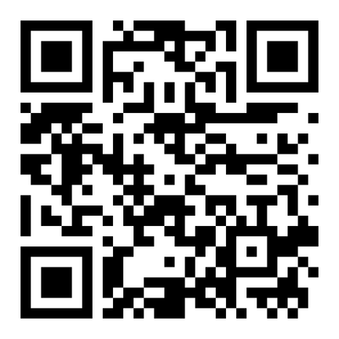

Connect to Careers
Date: Tuesday March 3, 2026
Time: 10 AM - 3 PM (arrive at 2 PM latest)
Location: Hamilton Convention Centre, 1 Summers Lane
Event Details:
  You must register in advance
  100+ Employers
  2000+ job seekers - very busy! (not really kid-friendly)
  Website has all the information about employers - do your research.
  Give yourself at least 2 hours - the line may be long, dress for the weather

Slide 3

How to Register
To register you will need:
  First & Last Name
  Email Address
  City you live in
  Create a Password
Confirm if you are:
  Student
  Alumni
  Community Job Seeker
There are additional questions about level of education, previous role titles, jobs you are looking for - these are NOT mandatory
Notes:
Optional – just to show the steps they would take if they want to register on their own time. We will support on-site registration during the workshop.

Slide 4

What is a Job Fair? Benefits of Networking
Presentation #1

Slide 5






Top Tips for
Job Fair Success

Slide 6
AGENDA
Current Labour Market Trends
What to Expect at a Job Fair
How to Prepare Yourself
Networking Tips

Slide 7
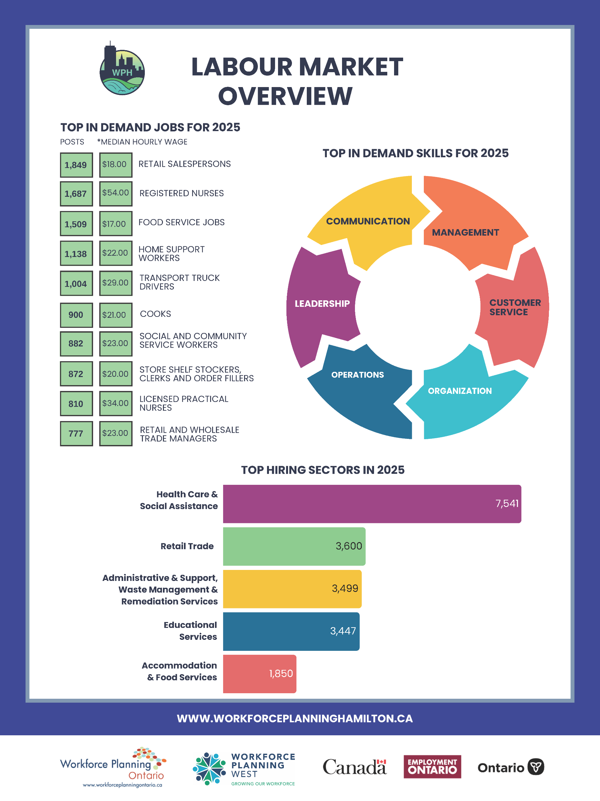



Top In Demand Jobs (2025)
Workforce Planning Hamilton’s Job Board collects data on in-demand jobs in the region.

Slide 8
Top Hiring Sectors (2025)

Slide 9
WHAT TO EXPECT AT A JOB FAIR
A job fair is a place to:
Locate employment/connect with employers
Obtain important information on your targeted field of work
Examine your competition
Network

Slide 10
WHAT TO EXPECT AT A JOB FAIR
What job(s) are you looking for?
One position or multiple positions? Visit the C2C website and explore the different employers present. Become familiar with the type of positions they hire for.
You should have a resume for each field of employment.

Slide 11
C2C - Hiring Sectors
Administrative and support, waster management and remediation services
Finance and Insurance
Automotive and vehicle
Government
Professional, scientifical, and technical services
Construction
Healthcare
Public administration
Consulting
Hospitality
Technology
Educational services
Manufacturing
Energy and natural resources
Not-for-Profit
Environmental
Accounting

Slide 12



Company
Overview
Hiring for:
A leasing company in 1957 has expanded to a network of mobility solutions that serves customers in more than 90 countries and territories around the world.
Management Trainee
Document Controller (Hamilton area)
Construction assistant
Station Superintendent
Coordinator- Communications and Graphic Design
Coordinator- Communications and Graphic Design
Architectural Lead
As vertically-integrated builder of signature properties and major infrastructure.
A design and construction firm operated by Grayson and Emily Bernard, specializing in architectural, interior, and landscape design
Administrative jobs
Construction worker
Project Engineer - US Cross Border Assignment
Notes:
Prepared by YMCA/YWCA staff
Encourage attendees to visit their table to learn more about who is hiring

Slide 13
WHAT TO EXPECT AT A JOB FAIR
When connecting with employers, be ready to share your introductory statement (elevator pitch)
Know your skills and abilities, and make sure to share this with employers.
Remember there are questions you can ask recruiters at career and job fairs.
You should be strategic and ask questions that will give you useful information.
Let’s discuss what that looks like.

Slide 14
STRATEGIC PLANNING QUESTIONS
These questions are designed to give the job-seeker more information about the hiring process for each employer.
What kind of positions are in high demand at your company?
Does your company hire continually or at certain times of the year?
How long does the hiring process take? What does it consist of?

Slide 15
STRATEGIC COMEBACK QUESTIONS
These questions are designed to give job-seekers the chance to respond to the recruiter's negative answer with a positive spin.
You can still demonstrate your interest in their company and leave a good impression.
Some questions may give you the chance of gathering details on what the company is looking for in an employee.
What kinds of skills, experience and/or certifications do you look for in the employees you hire?
What are the characteristics of your most successful employees?

Slide 16
GET THE BEST OUT OF THE JOB FAIR
Strategies Be prepared, arrive on time, bring your resume, dress for success, and have a positive attitude Ask for information on where to locate your targeted employers – Look for a map Visit your top organizations first, but don’t forget the other organizations attending! | Services and Workshops Resume Review – available today Speed Interview Practice – available today Computer lab with access to printers – EO providers/Library Talk to a service provider at the HIPC table during the job fair

Slide 17

NETWORKING AT A JOB FAIR
Information gathering
Building contacts for meetings
Meeting new people in a business or social context
You never know when you may meet someone who may be able to help you in your job search or career planning!
Notes:
Each ATS is different, but most of the top ATS have the same general features. These features include:
Resume ParsingThe ATS will extract and organize the parts of each resume into structured information.Resume StorageOnce entered into the ATS, resumes remain in the system as possible candidates for future positions.Keyword SearchRecruiters and hiring managers can search by any keyword, often with the Boolean search. Boolean search connects keywords using AND, OR, NOT, and NEAR.FiltersFilters can include the job seeker’s location, the source of your application, how long ago you applied to the company, and whether or not you are a referral.Automated Email CustomizationCompanies can customize rejection letters and other emails to ensure that applicants get a response to their application.It’s good to note that there are hundreds of applicant tracking systems, each featuring unique specialties. They don’t all parse, rank, or filter your resume in the same way.
This means that optimizing your formatting or keyword density for one ATS may not be ideal for another. For this reason, Jobscan now offers ATS-specific advice. Just add the URL in your Jobscan match report and the tool will return unique tips based on the company’s applicant tracking system.

Slide 18
STEPS FOR NETWORKING
Step 1: Develop a networking plan
What is your goal for networking?
Career planning or career change
Upgrading your skills, or
Job Searching

Slide 19
STEPS FOR NETWORKING
Step 2: Research
Locate your target company
Identify who runs the department/decision makers
Diversify your resources for job leads
Research for referrals
Gather information about the industry

Slide 20
STEPS FOR NETWORKING
Step 3: Review & Prepare
Review
Your top-selling skills
Accomplishments
Attributes
Prepare
Your introductory statement/elevator pitch
Networking cards
Information interview script

Slide 21
KNOW YOUR SKILLS!
Transferrable Skills
Technical Skills
Computer, machinery, editing, languages, hands on equipment, motor vehicle, record keeping, troubleshooting
Personal Attributes
Cooperative, outgoing, dependable, diligent, adaptable, perceptive, well organized and customer oriented
Soft Skills
Coaching, evaluating, analyzing, supervising, motivating, training, team work
Notes:
https://www.livecareer.com/resources/resumes/how-to/write/resume-keywords

Slide 22
TIE IT ALL UP
Have resumes ready for each job you are targeting
Get prepared for a speed Interview
Have a solid networking plan
Prepare your elevator pitch (YWCA presentation- Elevator Pitch)

Slide 23


