Slide 1
New to Canada? Know your Workers Rights
Session # 1: ESA Introduction

Slide 2
Hamilton Immigration Partnership Council (HIPC)
Established in 2009
One of more than 80 Local Immigration Partnerships across Canada
Collaborator and convener
Funded by IRCC, embedded in Economic Development in City of Hamilton
Membership includes a diversity of sectors and organizations

Slide 3
Disclaimer!
We cannot provide individual legal advice during this presentation.
This presentation should not be interpreted as legal advice as we are only providing information on employment laws in Ontario
If you have questions about an employment-related issue or other legal matters, please call your local community legal clinic. For Hamilton residents, that is the Hamilton Community Legal Clinic, 905 527-4572
Thank you for your understanding.

Slide 4
Glossary
Legislation = The Law or Rules
Example: Employment Standards Act (ESA)
Termination = Getting Fired or Let Go
Reprisal: You’re boss punishing you for standing up for your workplace rights
Severance: A type of payment you may be entitled to if you’re fired

Slide 5
What is the ESA?
It is Ontario law and establishes minimum workplace standards that employers must follow in Ontario.
Even if you sign an employment contract stating otherwise, your rights under the ESA cannot be denied.
It’s important to keep up to date with new rules and regulations as the ESA has changed over time.
The ESA does not cover all workers, and there are special exemptions to many ESA protections.
The ESA applies regardless of citizenship or immigration status.

Slide 6
Who is NOT covered by the ESA?
The ESA protects provincially regulated “employees”
Some workers are exempted, including Self-employed individuals, Students in co-op placements, Federal employees, etc.
The most common exemption is wage-based, meaning that while other rights apply, the right to minimum wage may not.
Self-Employed Individuals
Example: App-Based Gig Workers
Federally Regulated Employees
Example: Airport Workers
Student Placements
Example: Co-op Students

Slide 7
Minimum Wage
General Minimum Wage: $16.55
Student Minimum Wage $15.60
Homeworkers Wage $18.20
If you are called into work and sent home before 3 hours, your employer is required to pay a minimum of 3 hours of your hourly wage.

Slide 8
Hours of Work & Overtime
Daily maximum = 8 hours per day
OR
established regular workday if over 8 hours
Weekly maximum = 48 hours per week
Overtime pay is required when employees work over 44 hours per week (1.5 X Regular Rate of Pay)

Slide 9
What is Considered Work?
Work hours are based on the time you are working at your job
OR
when you are not actively doing work, but your employer requires you to stay at your workplace
You must be paid for training!
Commuting typically doesn’t count toward work hours
Notes:
Work is deemed to be performed even where the employee is not working but is required to remain at work and is holding himself out as ready for work;
So if, for instance, you are working at a salon and are waiting for walk ins to get their hair cut – the time you spend at the workplace waiting to work are hours worked.
I.e. if you have a shift at a restaurant that is for 8 hours, and you are sent home early after just an hour, they need to stilll pay you for three hours.
**also under the new changes coming into effect, you will be entitled to 3 hours pay at your regular rate if your shift is cancelled within 48 hours of its scheduled start.

Slide 10
Payment of Wages
Your employer is required to establish regular pay periods and paydays
All earned wages within a pay period (excluding accrued vacation pay) must be paid by the designated payday
Payment methods can include cash, cheque, direct deposit or e-transfer
Your employer is required to provide you with a paystub following the payment of wages

Slide 11
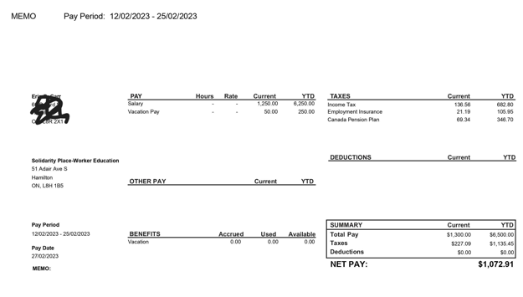

Slide 12
Rest Periods & Breaks
All employees must receive an eating period of at least 30 minutes after 5 hours of work.
You can agree with your employer or supervisor to split your break times
Break times typically don’t count towards your hours of work
You should not be working at all during your breaks

Slide 13
Breakout Activity

Slide 14
After you review each scenario:
1) Is your employer legally allowed to do that?
2) What steps should you take to address that particular issue?
Scenario # 1:
Your employer informs you that the business is struggling and will now have to pay you below the minimum wage if you want to keep your job. You agree in writing to the employer's demands because your cell phone bill is due, and you do not want your service disconnected.
Scenario # 2:
Your employer had previously paid your wages in the form of a cheque with a corresponding paystub every two weeks but has now indicated that you will be paid via e-transfer on your payday. After receiving your first e-transfer, your employer did not provide you with a corresponding pay stub because the company's payroll accountant was on vacation.
Scenario # 3:
You typically work Monday through Thursday at your place of employment. After Good Friday, you notice that your employer did not provide you with holiday pay. Your boss indicates you are not entitled to holiday pay because you do not usually work on Friday.
Scenario # 4:
You work as a hairdresser at a barber shop, and your weekly earnings are based on commissions. Last week, you worked 20 hours but only earned $200 in commissions, much less than the $331 you would be entitled to if you worked 20 hours at Ontario’s minimum wage rate.

Slide 15
Vacation Pay
Vacation pay is mandatory for all employees in Ontario
Less than 5 years of service means you are entitled to at least 2 weeks of vacation
More than 5 years of service means you are entitled to at least 3 weeks of vacation
Less than 5 years of working for an employer (4% of wages)
More than 5 years of working for an employer (6% of wages)
You can agree to your vacation pay being paid out every pay period.

Slide 16
Leaves of Absences
Personal Sick Leave
Employers cannot threaten, fire or penalize you for taking a protected leave of absence
Must give the employer reasonable notice if possible
3 days per year (unpaid)
Employer can request a doctor’s note based on “reasonable circumstances”
Family Responsibility Leave
3 days per year (unpaid)
To use for “family emergencies”
Bereavement Leave
2 days per year (unpaid)

Slide 17
Holiday Pay
Employees get time off with holiday pay on all statutory holidays.
Employees are entitled to the day off with ‘public holiday pay’ if they worked the shift before and after the public holiday.
Recognized public statutory holidays in Ontario: New Year's Day, Family Day, Good Friday, Victoria Day, Canada Day, Labour Day, Thanksgiving, Christmas, and Boxing Day.
If you are required to work on a holiday, you are entitled to Holiday Pay and Premium Pay (1.5 X Regular Rate of Pay)
OR you can agree to take another day off in lieu with public holiday pay

Slide 18
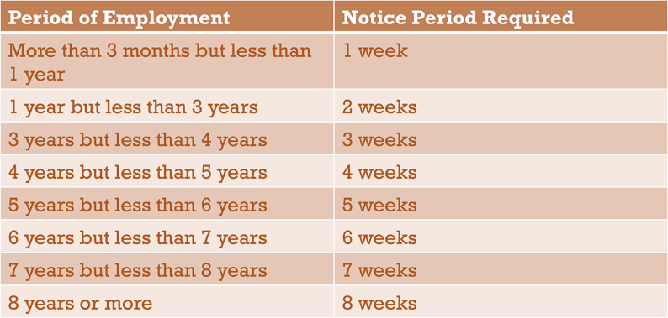
Employment Termination
What is “just cause”?
What is “without cause”?
For terminations without cause (3+ months), employers provide notice or termination pay.
Outstanding wages must be paid promptly
Termination notice/pay varies with service length 🡪 talk to a lawyer about whether you are entitled to more than your ESA termination pay.

Slide 19
Severance Pay
On top of notice of termination under the ESA, some employees should also be given “severance pay”

Slide 20
Employment Contracts
Contracts can be entered into via verbal agreement
Make sure you keep a copy of your contract
You have the right to review the contract in its full scope free of duress
Contracts cannot sign away your ESA rights

Slide 21
Employer Reprisal
Your boss CANNOT harass, intimidate or fire you for asking them to follow the law
Employees who have experienced reprisal can file a claim with the Ministry of Labour
The employer has to prove that the reprisal did not happen
Employees whose employer has broken the law can sue their employer in civil court (e.g. Small Claims Court) OR they could complain to the Ministry of Labour.

Slide 22
Key Takeaways
Keep records of your communication with your employer: texts, emails, phone calls, and letters.
Keep copies of every document you receive from your employer: contract, pay stubs, cheques, Record of Employment (ROE), termination letter, etc.
Write down any information about your boss and the company that you can find: name, title, work and home address, phone numbers, license plate number.
Ask for time to read a contract before you sign it. If your boss pressures you to sign your contract without reading it, try to get a copy of the contract or take a photo of it. Keep copies of any contracts you receive.

Slide 23
Questions?

Slide 24
Thank you for Listening!

