Slide 1



RESUME TIPS &TECHNIQUES

Slide 2
Agenda
By end of this presentation, you will be able to:
List the benefits of an effective resume
Choosing the right resume format that gets you the desired response
Create a resume with accomplishments

Slide 3

LET’S TAKE THIS QUICK QUIZ:
How long does an employer/recruiter spends looking at your resume?
1
1- 3 minutes
2
30-40 seconds
4
3
5- 10 minutes
10 – 15 seconds
Notes:
ATS – Applicant Tracking System
* If you’re applying through an ATS. However, if you’re sending your resume to your contact or another actual person, use your “networking” resume. Networking resume can have more elaborate formatting, graphics, etc. It’s used to impress someone – grab their attention.
Answer: 10-15 seconds

Slide 4

Your resume may be overlooked because…
It may not be targeted to a specific position
Not visually appealing
Poor/wrong formatting
Not telling your story.

Slide 5
WHAT IS AN EFFECTIVE RESUME !!
A resume with content that is of interest to employers
Speaks to their needs
NOT a list of your job duties, tasks and responsibilities; it is your accomplishments/achievements

Slide 6
RESUME COMPONENTS
Personal Contact Information and Formatting
  Name, Address, Telephone and Email
Objective
  Position applying for
  56% prefer some sort of objective/summary or profile
Highlight of Qualifications
  Years of experience, qualifications, accomplishments, skills
Work Experience
  The company name, the job title and the dates you work there
  Duties/responsibilities and accomplishment
Notes:
Each ATS is different, but most of the top ATS have the same general features. These features include:
Resume ParsingThe ATS will extract and organize the parts of each resume into structured information.Resume StorageOnce entered into the ATS, resumes remain in the system as possible candidates for future positions.Keyword SearchRecruiters and hiring managers can search by any keyword, often with the Boolean search. Boolean search connects keywords using AND, OR, NOT, and NEAR.FiltersFilters can include the job seeker’s location, the source of your application, how long ago you applied to the company, and whether or not you are a referral.Automated Email CustomizationCompanies can customize rejection letters and other emails to ensure that applicants get a response to their application.It’s good to note that there are hundreds of applicant tracking systems, each featuring unique specialties. They don’t all parse, rank, or filter your resume in the same way.
This means that optimizing your formatting or keyword density for one ATS may not be ideal for another. For this reason, Jobscan now offers ATS-specific advice. Just add the URL in your Jobscan match report and the tool will return unique tips based on the company’s applicant tracking system.

Slide 7
RESUME FORMATTING TIPS!
Be pleasing to the eye – Easy to read
Use white or ivory color paper
Use Font Size 12 – Arial or Times New Roman
Ensure your personal information is accurate
Tailor your resume for each job you are applying

Slide 8
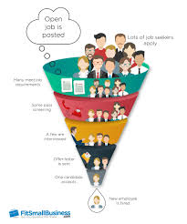
You Need a Resume That Gets You Through The ATS !
Applicant Tracking System disqualify 75% of applications instantly after they are submitted
(ATS) is a human resources software that acts as a database for job
Notes:
https://www.careeredge.ca/blog/13-ways-to-beat-the-applicant-tracking-system/

Slide 9
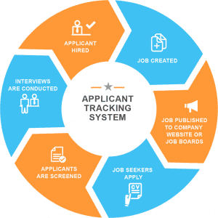
What Is An Applicant Tracking System?
An applicant tracking system (ATS) is a human resources software that acts as a database for job applicants. ATS are used by companies of all sizes to organize, search, and communicate with large groups of applicants. (JOBSCAN.CO)
Notes:
https://www.jobscan.co/applicant-tracking-systems

Slide 10

Format Can Make All the difference!
You can be creative with the visual appearance however, every resume should have the basics.
Let’s take a look a what that looks like….
Notes:
https://www.jobscan.co/applicant-tracking-systems

Slide 11
RESUME STYLES
Chronological Resume Lists your positions in reverse order starting with the most recent Canadian employers used to it. Not recommended if you have many unrelated positions or gaps in your work history. | Functional Resume Highlights your skills into major headings Good if seeking a career change. Difficult to connect what you have a accomplished with where you worked | Combination Resume Highlights your best skills and presents your positions in reverse order Its your chance to highlight your values in the best way and tailor your resume
Notes:
https://www.jobscan.co/blog/99-percent-fortune-500-ats/
From large corporations such as Starbucks, Nike, and U.S. Bank using established player Taleo, to startups like Airbnb, Venmo, and Squarespace using Greenhouse, knowing how to navigate these ATS can give job seekers a competitive edge.

Slide 12
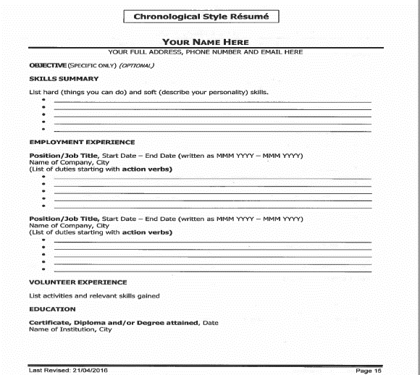

Slide 13
RESUME TIPS- CONT.
WORK EXPERIENCE:
write the company name, the city and country you worked, the time you work, the job tittle and the duties you performed.
Notes:
https://www.jobscan.co/applicant-tracking-systems

Slide 14
RESUME TIPS- CONT.
EDUCATION:
Include all the programs you have attended, trainings & certifications
Make sure every statement in your resume is true
Notes:
https://www.jobscan.co/applicant-tracking-systems

Slide 15
Use a chronological format
You have steady work experience ( no gaps)
Your work experience extends for a considerable period of time
You have shown advancement through your
employment experience
54.7 % of employers prefer chronological format.
Notes:
Regardless of each ATS’s strengths and weaknesses, they all follow the same basic process.
When you apply through an ATS, you will most likely be asked to answer what are called “knockout questions.” Knockout questions can be in the style of check boxes or short answer questions. Their purpose is to narrow the pool of applicants.
If an applicant answers any of the knockout questions unsatisfactorily, the resume will either be flagged or auto-rejected by the ATS. If you answer the knockout questions correctly, your resume will make it through to the next stage.
All applicant tracking systems parse and store resume information in ways that make candidates easy to filter and search by keyword

Slide 16
OBJECTIVE OR SUMMARY
An objective with a job title is a great starter
  Objective: Network Administrator.
  Objective: Network Administrator where 3 years of successful experience and training will add value
Notes:
Each ATS is different, but most of the top ATS have the same general features. These features include:
Resume ParsingThe ATS will extract and organize the parts of each resume into structured information.Resume StorageOnce entered into the ATS, resumes remain in the system as possible candidates for future positions.Keyword SearchRecruiters and hiring managers can search by any keyword, often with the Boolean search. Boolean search connects keywords using AND, OR, NOT, and NEAR.FiltersFilters can include the job seeker’s location, the source of your application, how long ago you applied to the company, and whether or not you are a referral.Automated Email CustomizationCompanies can customize rejection letters and other emails to ensure that applicants get a response to their application.It’s good to note that there are hundreds of applicant tracking systems, each featuring unique specialties. They don’t all parse, rank, or filter your resume in the same way.
This means that optimizing your formatting or keyword density for one ATS may not be ideal for another. For this reason, Jobscan now offers ATS-specific advice. Just add the URL in your Jobscan match report and the tool will return unique tips based on the company’s applicant tracking system.

Slide 17
HIGHLIGHTS OF QUALIFICATIONS
Highlights of Qualifications
Extensive experiences working as a project management coordinator, risk management, quality assurance and preparing budgets for various projects.
Familiarity with business analysis and willing to learning new techniques
Providing excellent customer service, and clients and vendors’ queries and helping to solve business issues as they arise
Maintaining work ethics. And health and safety standards in the workplace
Experienced in managing operational duties and attending telephone calls
Quick learner who can pick up any technical or subject matter very quickly
Proficient in Microsoft Office, and Google Applications and knowledgeable in various software

Slide 18
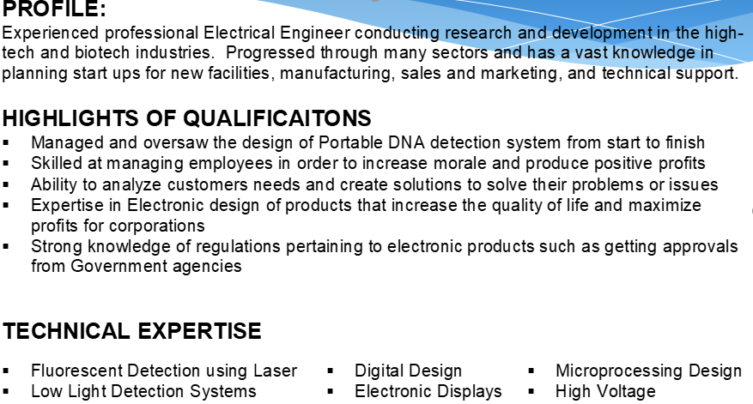
PROFILE/TECHNICAL EXPERTISE

Slide 19
PROFILE/SUMMARY/COMPTENCIES

Slide 20
KNOW YOUR SKILLS!
Transferrable Skills
Technical Skills
Computer, machinery, editing, languages, hands on equipment, motor vehicle, record keeping, troubleshooting
Personal Attributes
Cooperative, outgoing, dependable, diligent, adaptable, perceptive, well organized and customer oriented
Soft Skills
Coaching, evaluating, analyzing, supervising, motivating, training, team work
Notes:
https://www.livecareer.com/resources/resumes/how-to/write/resume-keywords

Slide 21
Highlight your strength
Highlight the best of the best of your accomplishments and strengths
Focus on the industry you are targeting
Highlight your added value- Branding

Slide 22


QUESTIONS
Have a question?
Type your question in the chat box or raise your hand!

Slide 23
www.IWCHamilton.ca
@iwchamilton
905-529-5209

