Slide 1
Welcome to
Employment Services
Notes:
Ice Breaker: Who is comfortable speaking up when they don’t know something?

Slide 2
Employment Ontario
Funded by the Ministry of Labour, Immigration, Training and Skills Development
Free of Charge
Assisting all Ontario job seekers and employers

Slide 3
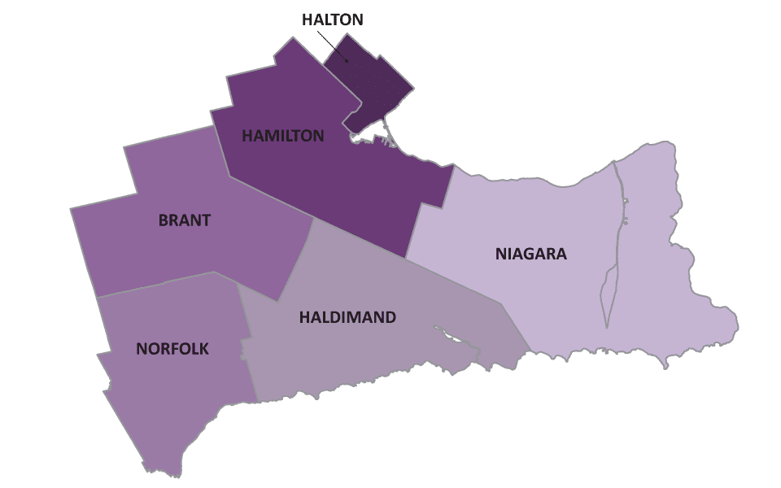
About Fedcap Canada
44 Service Providers
63 Locations
446 Provider FTE
Two (2) Offices:
- Hamilton
- Oakville

Slide 4
Employment Ontario

Slide 5
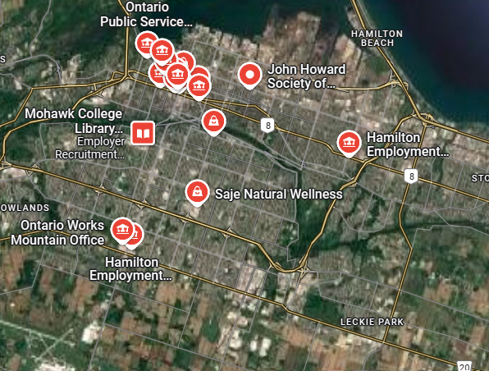
HAMILTON LOCATIONS

Slide 6
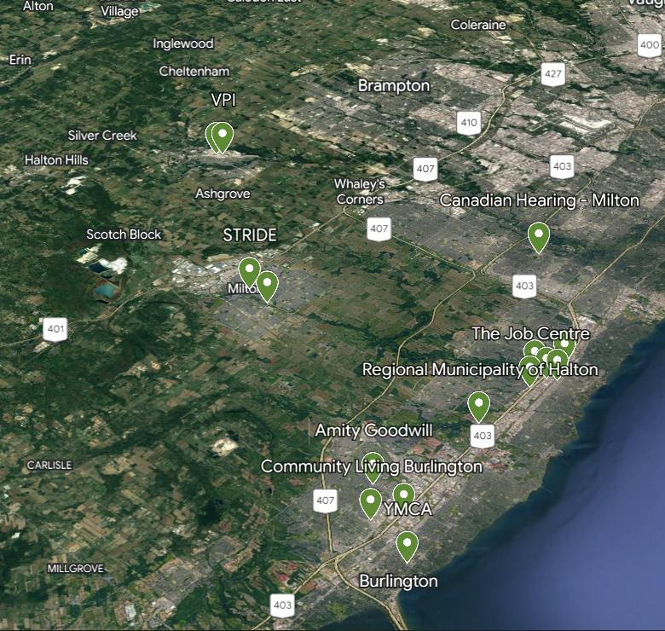
HALTON LOCATIONS

Slide 7
WHAT WE DO
One-on-one appointments
Identification and Refining of Education / Career Goals
Career Exploration
Job Search Techniques
Accountability / Motivation
Job Development
Referral to other relevant community programs/agencies

Slide 8
HOW WE CAN HELP
Job Resource and Information Centres
Individual support from an Employment Counsellors
Career Assessments
Referral to training and education programs
Employer incentives
Financial Support to overcome barriers to employment
Job development support with longstanding employer relationships
HR and recruiting assistance each step of the process

Slide 9
TRAINING & EDUCATION
Several programs for those who qualify
LBS – Literacy & Basic Skills
Short term training and micro credentialling
BJO – Better Jobs Ontario – skills training for in-demand jobs
Eligibility criteria, please do not register/pay for education without consulting with a qualified Employment Ontario Professional

Slide 10
CONTACT US NOW:

Slide 11
THANK YOU
ANY QUESTIONS?

Slide 12
LinkedIn & Job Search Success:
Stand Out & Get Hired!

Slide 13
Who has heard of LinkedIn before?

Slide 14
What is LinkedIn?
LinkedIn is a social network for work and career growth. It helps professionals connect, learn, share experiences, and find job opportunities.
Unlike Facebook, Instagram, or Twitter—where people share personal updates—LinkedIn is for professional networking. It is used to make business connections and talk about work experiences.
Why is LinkedIn Important?
In 2022, LinkedIn had over 800 million users, making it the world’s largest professional network.
Many recruiters and employers use LinkedIn to find job candidates.
Having a LinkedIn profile is very important in the Canadian job market.
If you are a newcomer, LinkedIn can help you start your career in Canada by connecting with employers and professionals.
WHAT IS LINKEDIN?

Slide 15
Professional Networking in Canada
Networking (building professional connections) is very important in Canada’s job market. Many jobs are not posted online—they are filled through personal connections. Your network can help you find these hidden job opportunities by recommending you for jobs in their company.
Why is Networking Important?
As a newcomer, you may not have a network in Canada yet.
Without connections, finding a job can be harder.
LinkedIn helps you start networking before you even arrive in Canada.
Your network can also teach you about your industry in Canada. You can learn how companies work, what skills are important, and how to prepare for jobs.
When used well, your network can help you find a job and grow your career in Canada.
WHY USE IT?

Slide 16
LinkedIn has a job search tool where employers post job openings in different industries and locations.
With the “Jobs” feature, you can:
Search for jobs by title, skill, company, or location
Sign up for job alerts to get updates about jobs that interest you
Follow companies to see when they post new jobs
If you want to work for a specific company, LinkedIn helps you connect with people who work there. You can:
See who in your network works at that company
Ask for a casual chat (coffee chat or informational interview) to learn more about the company
Build a strong connection and possibly ask for a referral
APPLY FOR JOBS

Slide 17
Your LinkedIn profile and posts create an image of who you are. Employers look at your profile to learn about your skills and experience.
By carefully creating your profile, you can:
Show your skills and strengths
Make a good impression on employers
Stand out as a strong candidate for jobs
Using LinkedIn to promote your personal brand helps you get noticed by employers and grow your career in Canada.
BUILDING ‘YOUR’ BRAND

Slide 18
TIPS TO FOLLOW
Before you start your job search in Canada, make sure your LinkedIn profile is complete and professional.
Use a Professional Photo: A clear, friendly photo with a plain background makes a strong first impression.
Write a Strong Headline & Summary: Your headline and summary should highlight your skills, experience, and what makes you unique.
Complete All Sections: Fill in your work experience, education, certifications, and skills—keep everything updated.
Get Recommendations: Ask former colleagues, managers, or teachers to write recommendations about your skills and work ethic.
Showcase Your Work: If possible, add a portfolio, project links, or work samples to stand out.
Stay Professional: Everything on LinkedIn is public—be professional, respectful, and post content related to your field.
Grow Your Network: Connect with former colleagues, industry professionals, and Canadian employers to expand your job opportunities.
A strong LinkedIn profile helps you get noticed by recruiters and grow your career in Canada!

Slide 19
What is an Elevator Pitch
and Why is it Important?
An elevator pitch is a short and clear introduction about yourself, usually 30 to 60 seconds long. It is like a quick speech that explains who you are, what you do, and what you are looking for.
Why is an Elevator Pitch Important?
First Impressions Matter – When meeting an employer or professional, a good elevator pitch helps you make a strong first impression.
Job Opportunities – You can use your pitch at job fairs, networking events, or even on LinkedIn to attract employers.
Confidence in Communication – Practicing your pitch helps you feel more comfortable when talking about yourself.
Saves Time – Since it’s short and clear, it keeps conversations focused and effective.

Slide 20
Now it’s your turn – WHAT IS YOUR PITCH?
"Hello, my name is [Your Name]. I experience in [Your Profession]. I specialize in [Your Skills or Industry]. I am currently looking for opportunities in [Job Role or Industry] where I can use my skills in [Specific Skill]. I am excited to learn and contribute to a great team.
"Hello, my name is [Your Name]. I am looking for work in [Industry/Field]. I am a quick learner, hardworking, and open to different opportunities where I can apply my skills in [Skill 1, Skill 2]. I’m eager to contribute and grow in a professional environment. Do you know of any openings or connections that could help me get started?“
"Hello, my name is [Your Name], and I am very interested in working with [Company Name]. I have experience in [Industry/Field] with skills in [Skill 1, Skill 2]. I am a fast learner, highly adaptable, and passionate about contributing to a dynamic team. I am looking for an opportunity where I can apply my skills and grow within the company. I would love to learn more about how I can add value to your team—are there any roles that might be a good fit for someone with my background?"

Slide 21
THANK YOU
ANY QUESTIONS?

